Slide 1



Slide 2


Slide 3
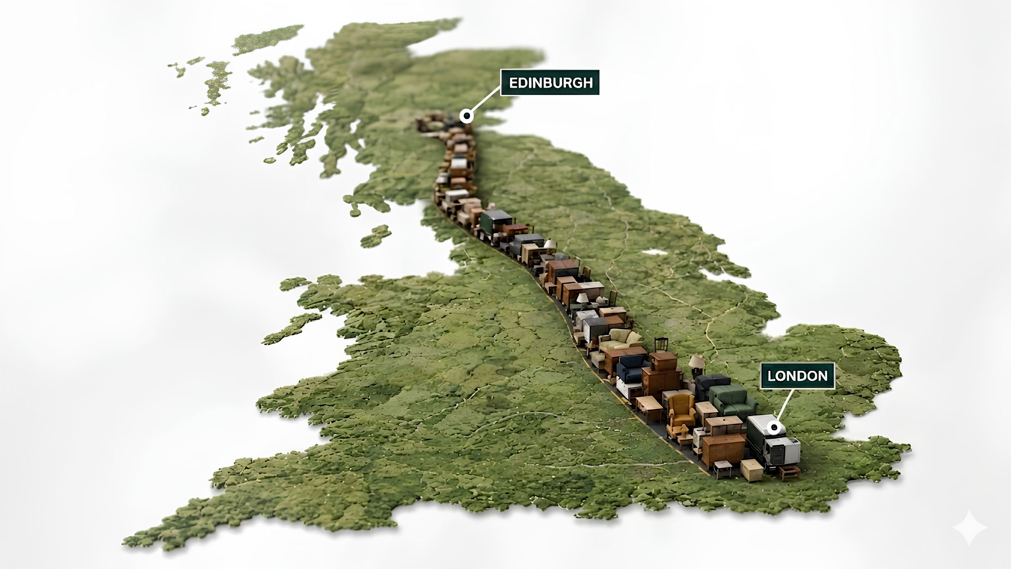



In the UK alone,
22 Million
pieces of furniture hit a landfill each year
670,000
tonnes of waste
Enough furniture to fill a convoy stretching from London to Edinburgh every single year!
And over half was still usable!
NLWA / WRAP

Slide 4
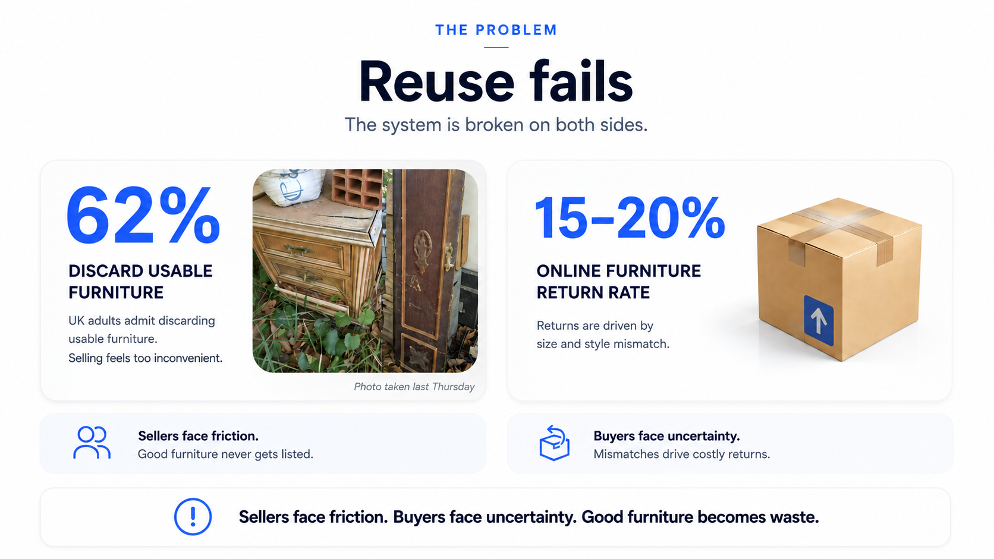

Slide 5


Slide 6


Slide 7
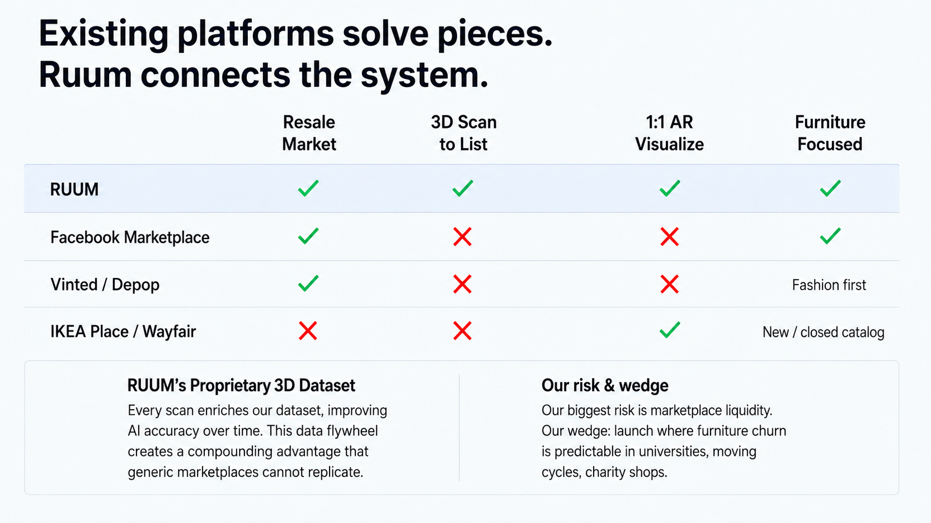

Slide 8


Slide 9
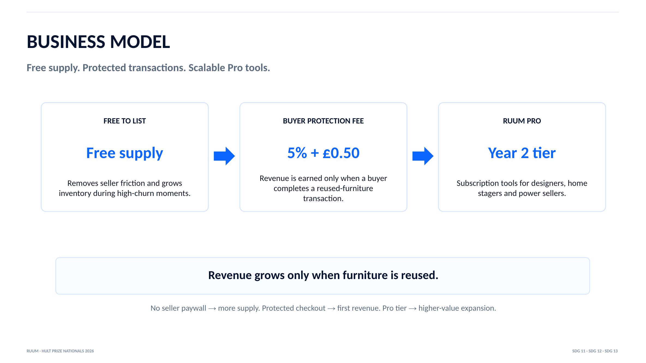

Slide 10
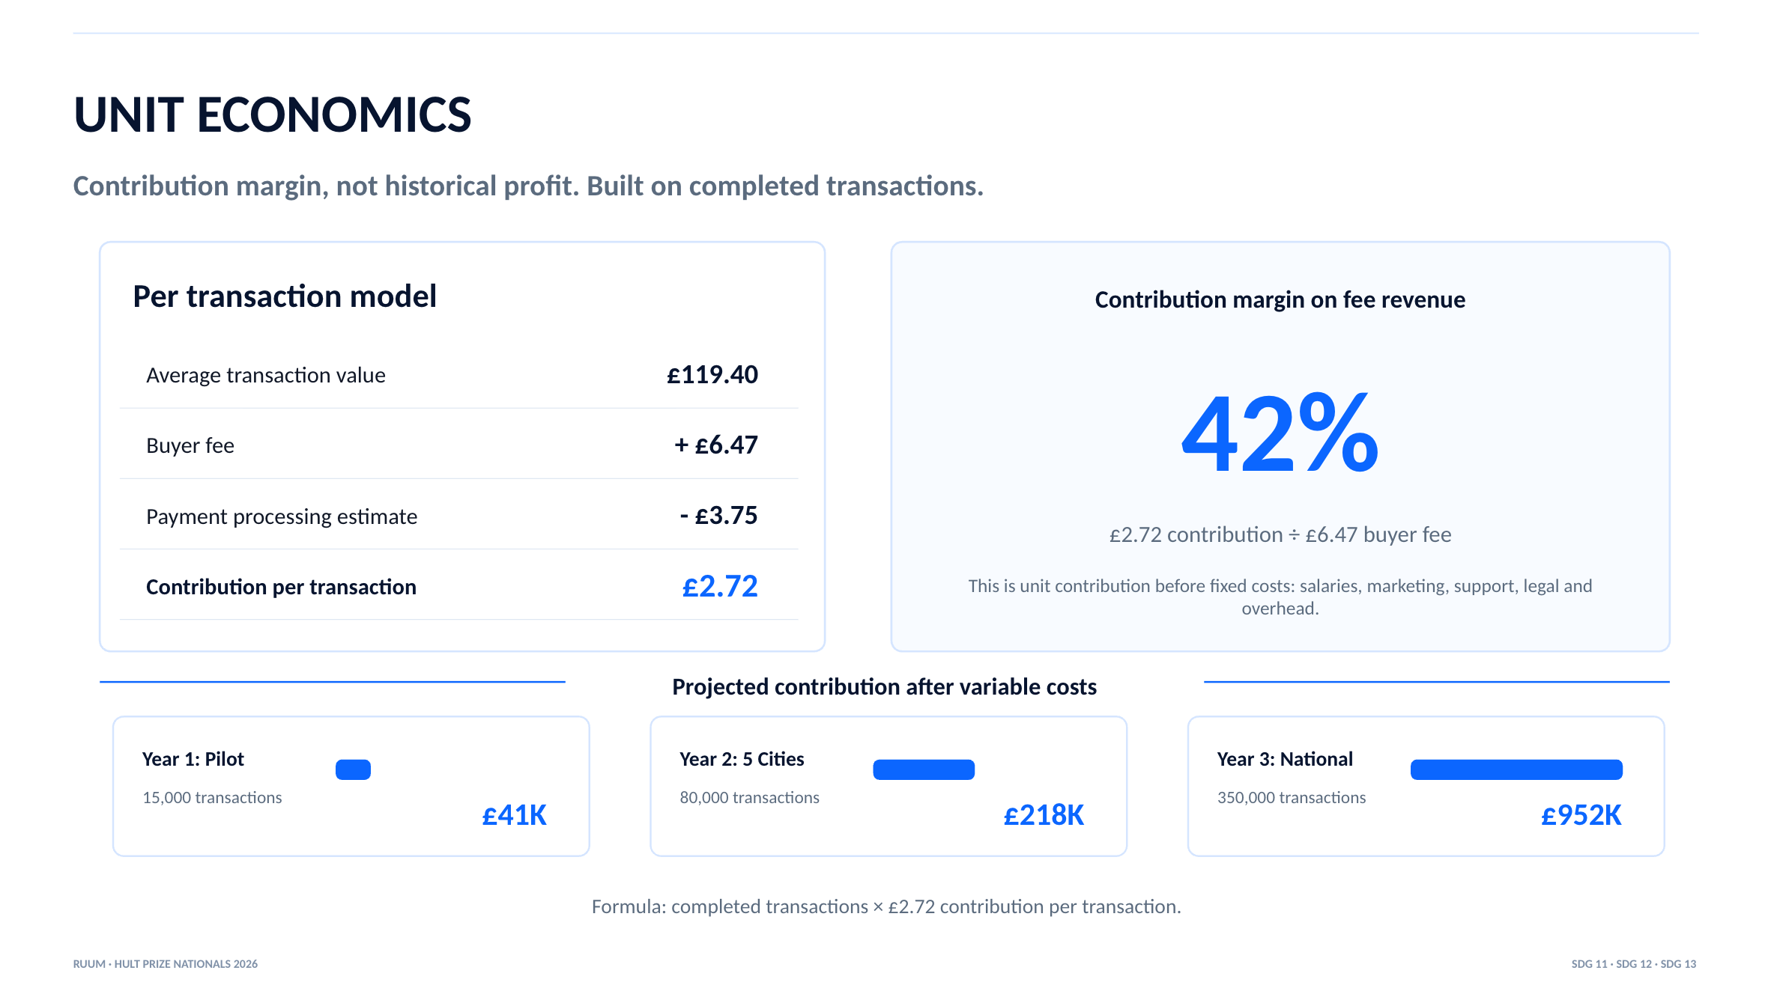

Slide 11


Slide 12


Slide 13
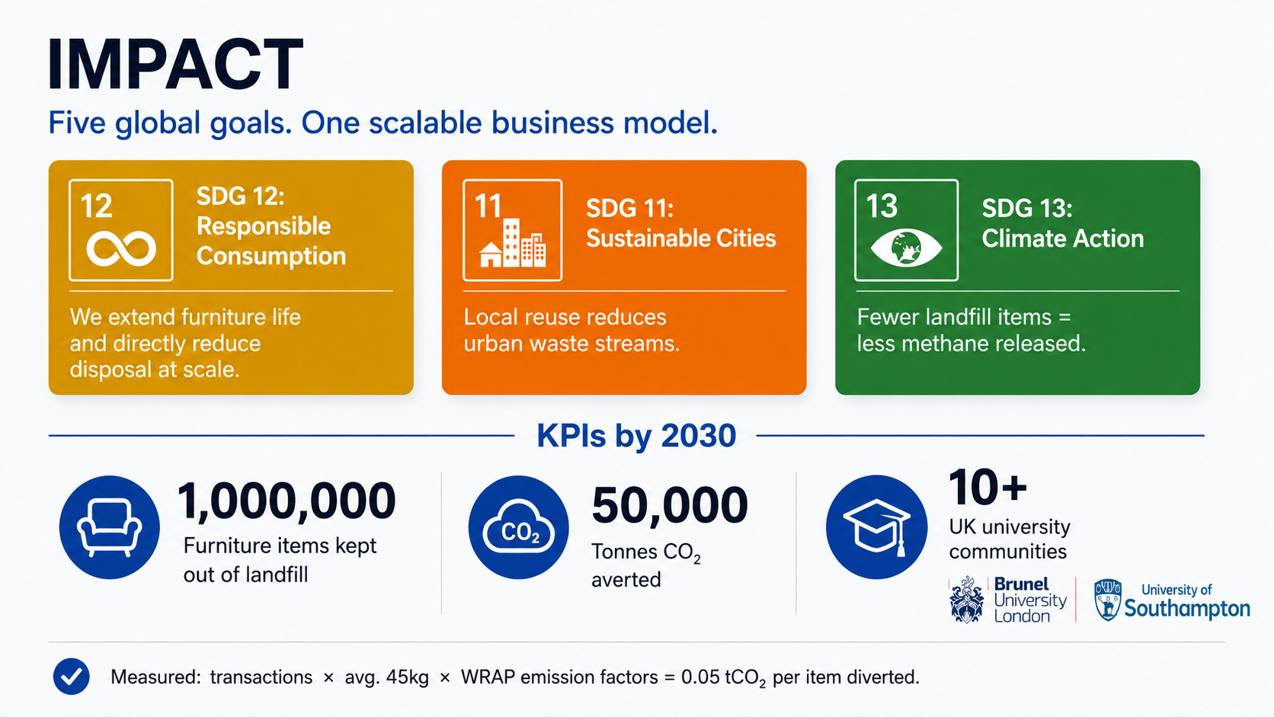

Slide 14


Slide 15



Slide 16


